Slide 1
ECE 3317
Dr. Jiefu Chen
Review 2

Slide 2
Equations of Transmission Line in Frequency Domain
“Telegrapher’s Equations (TEs)”
Lossy wave equation
(no exact solution)
γ = propagation constant [1/m]
α = attenuation constant [nepers/m]
β = phase constant [radians/m]

Slide 3
Solutions in Frequency Domain
Forward traveling wave:
Denote
Then
Backward traveling wave:

Slide 4
Reflection in Frequency Domain
Z_{g}
I(z)
+
Sinusoidal source
S
Z₀
V(z)
Z_{L}
-
z = 0
z

Slide 5
Input Impedance at Any Point on the Line
Z_{g}
I(z)
Z₀
+
S
V(z)
Z_{L}
-
z = 0
Z_{in}
l
z
For lossless line

Slide 6
Standing Wave
Consider a lossless transmission line that is terminated with a load:
Z_{g}
I(z)
+
Sinusoidal source
S
Z₀
V(z)
Z_{L}
-
z = 0
z
Voltage on the line:
Maximum voltage:
Minimum voltage:
Current on the line:
Maximum current:
Minimum current:

Slide 7
Standing Wave Ratio
find ZL from standing wave pattern:

Slide 8
Smith Chart
Impedance ←→ reflection coefficient
Admittance ←→ reflection coefficient
Impedance ←→ admittance
Move along transmission line ←→ rotation on Smith Chart
Find out normalized voltage and SWR by Smith Chart

Slide 9
Two Types of Smith Chart
Smith Chart based on impedance
Smith Chart based on admittance

Slide 10
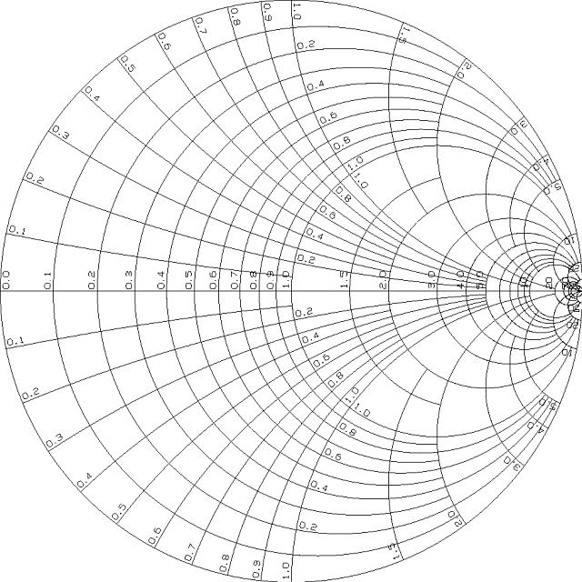
Impedance Chart
S/C
Perfect Match
O/C

Slide 11
Admittance Chart
Perfect Match
O/C
S/C

Slide 12
2-in-1 Chart
if you feel confused by this 2-in-1 chart, use impedance chart and admittance chart separately …

Slide 13
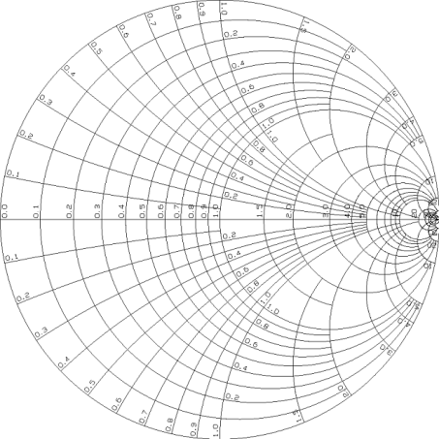
Move along transmission line: rotation on Smith Chart
for both impedance chart and admittance chart
Z_{g}
Generator
Transmission Line
Load
To generator
S
Z₀
Z_{L}
z = 0
z = -l
To generator
z

Slide 14
Normalized Voltage and SWR
for impedance chart
also called as crank diagram
Normalized voltage
The SWR is read off from the normalized resistance value on the positive real axis.
positive real axis

Slide 15
Example
Given:
SWR = 5.8

Slide 16
Examples of Smith Chart

Slide 17
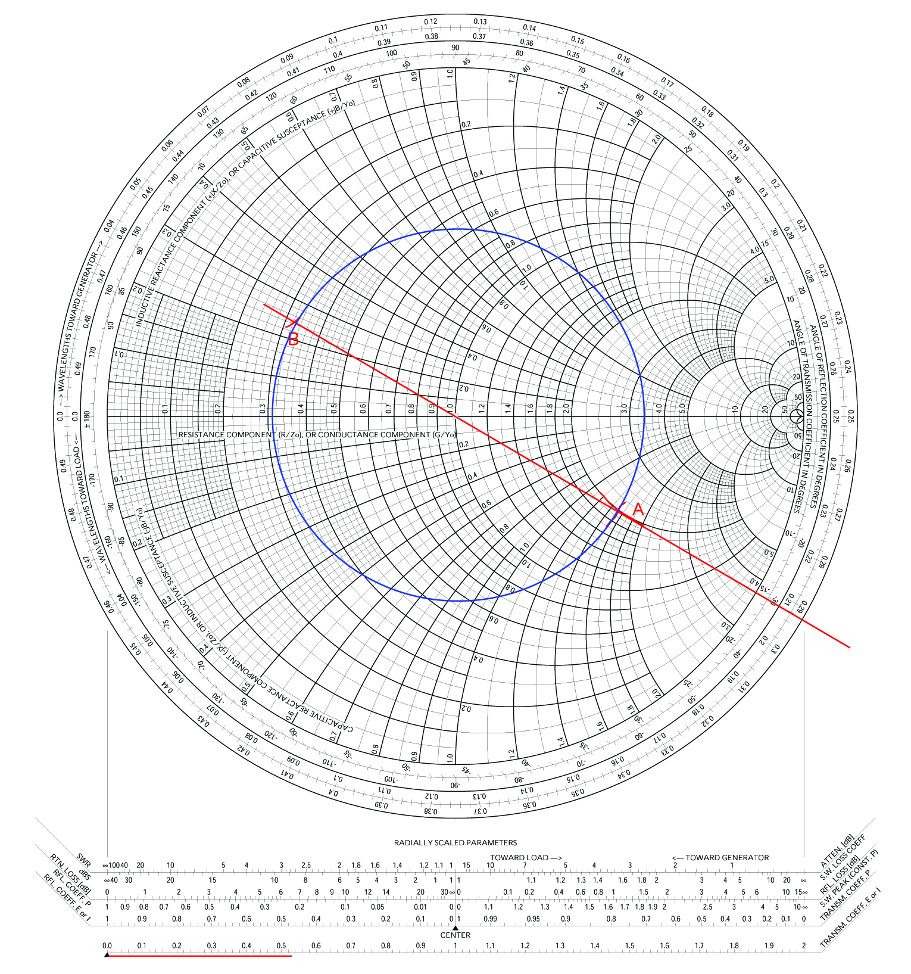

Slide 18
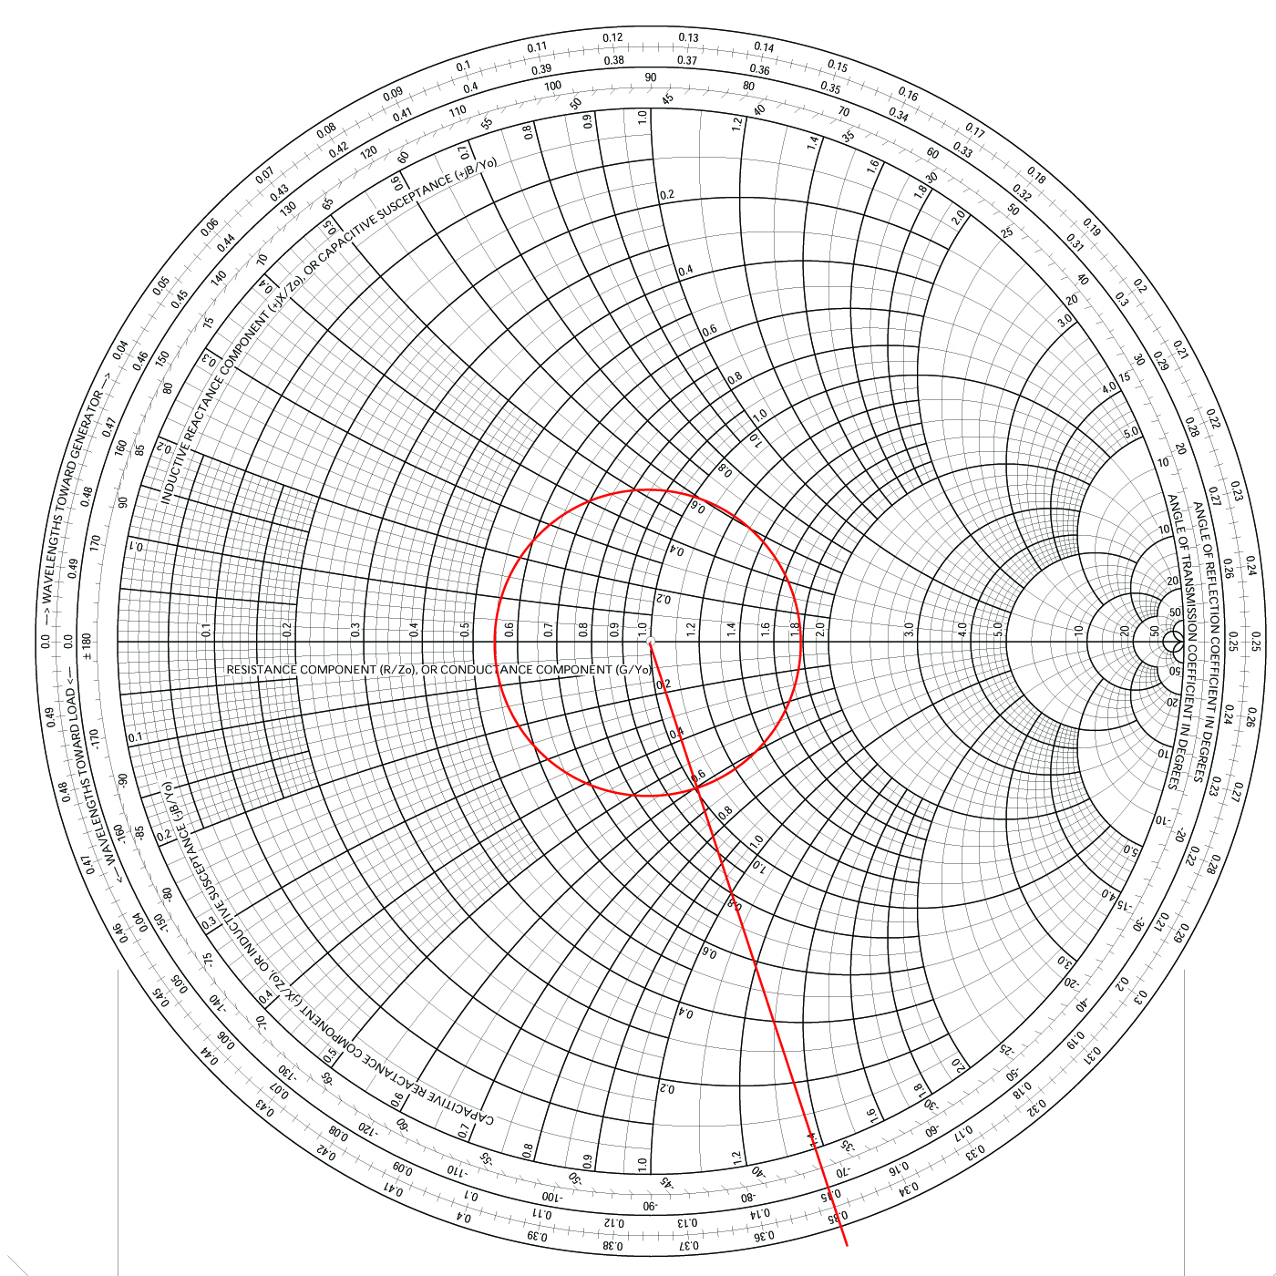
Examples of Smith Chart

Slide 19
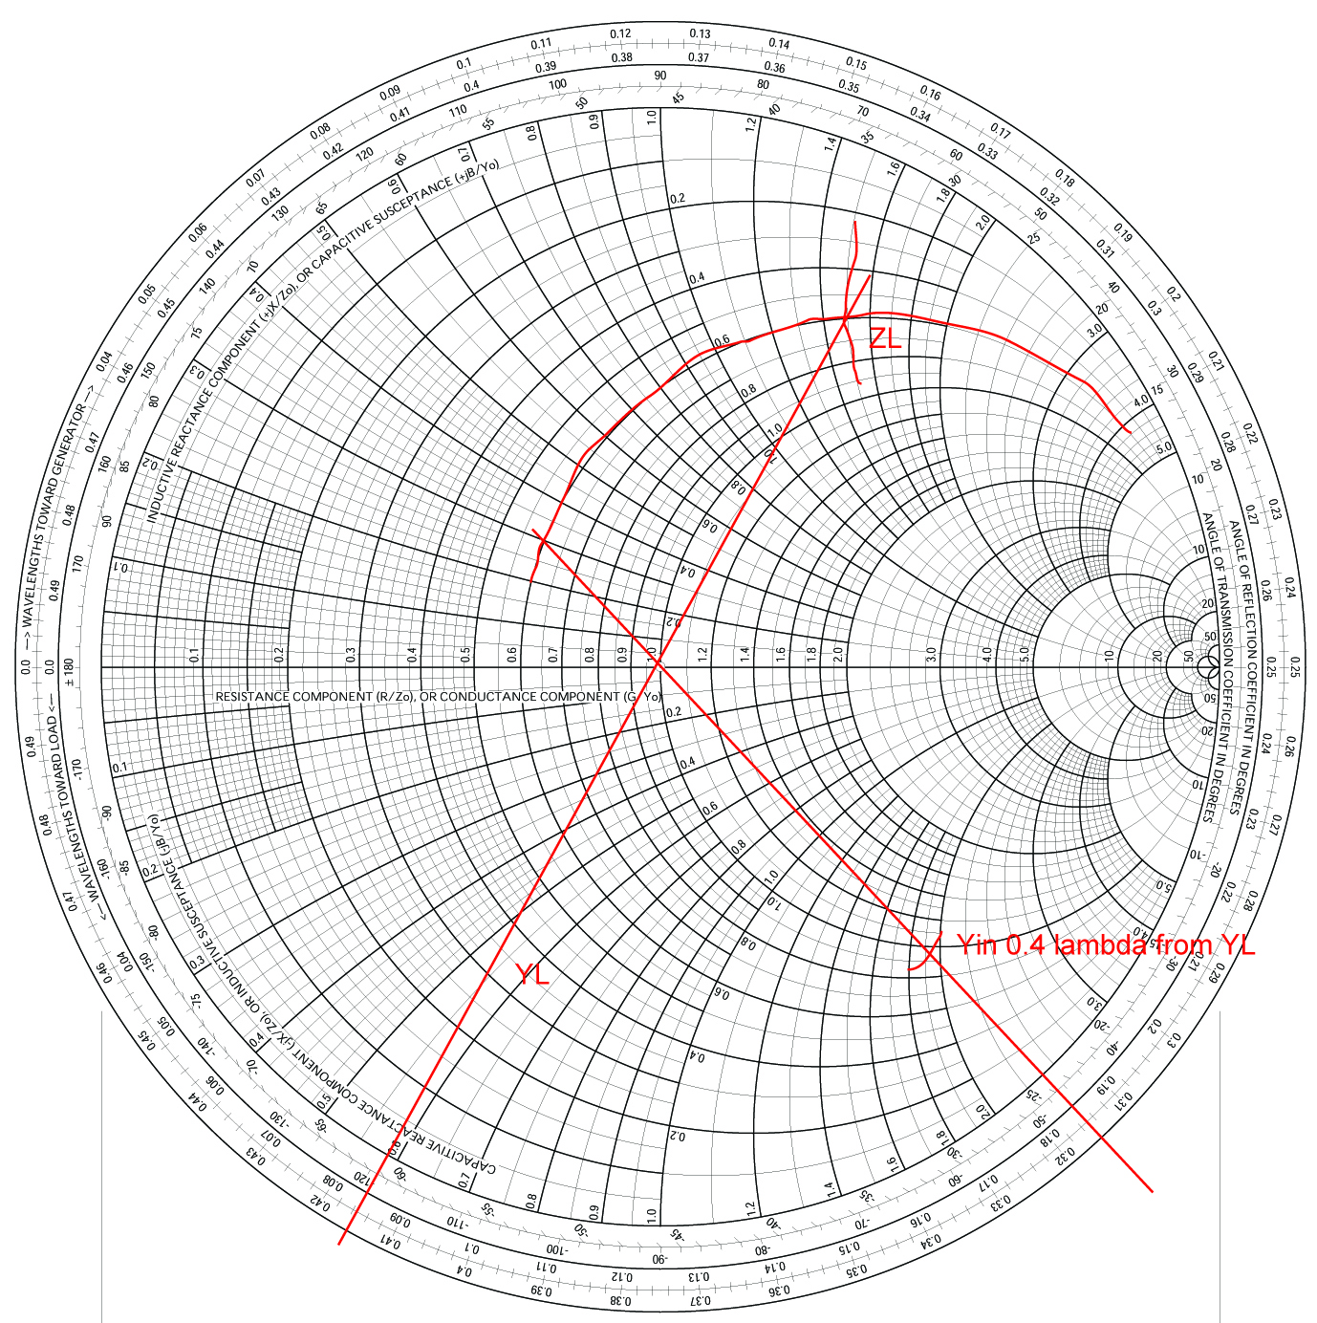
Examples of Smith Chart

Slide 20
Impedance Matching
Quarter-wave transformer
Real load: analytical solution
Complex load
With shunt shorted stub at load: analytical solution
With extension: by Smith Chart
Single stub matching: by Smith Chart

Slide 21
Examples of Impedance Matching

Slide 22
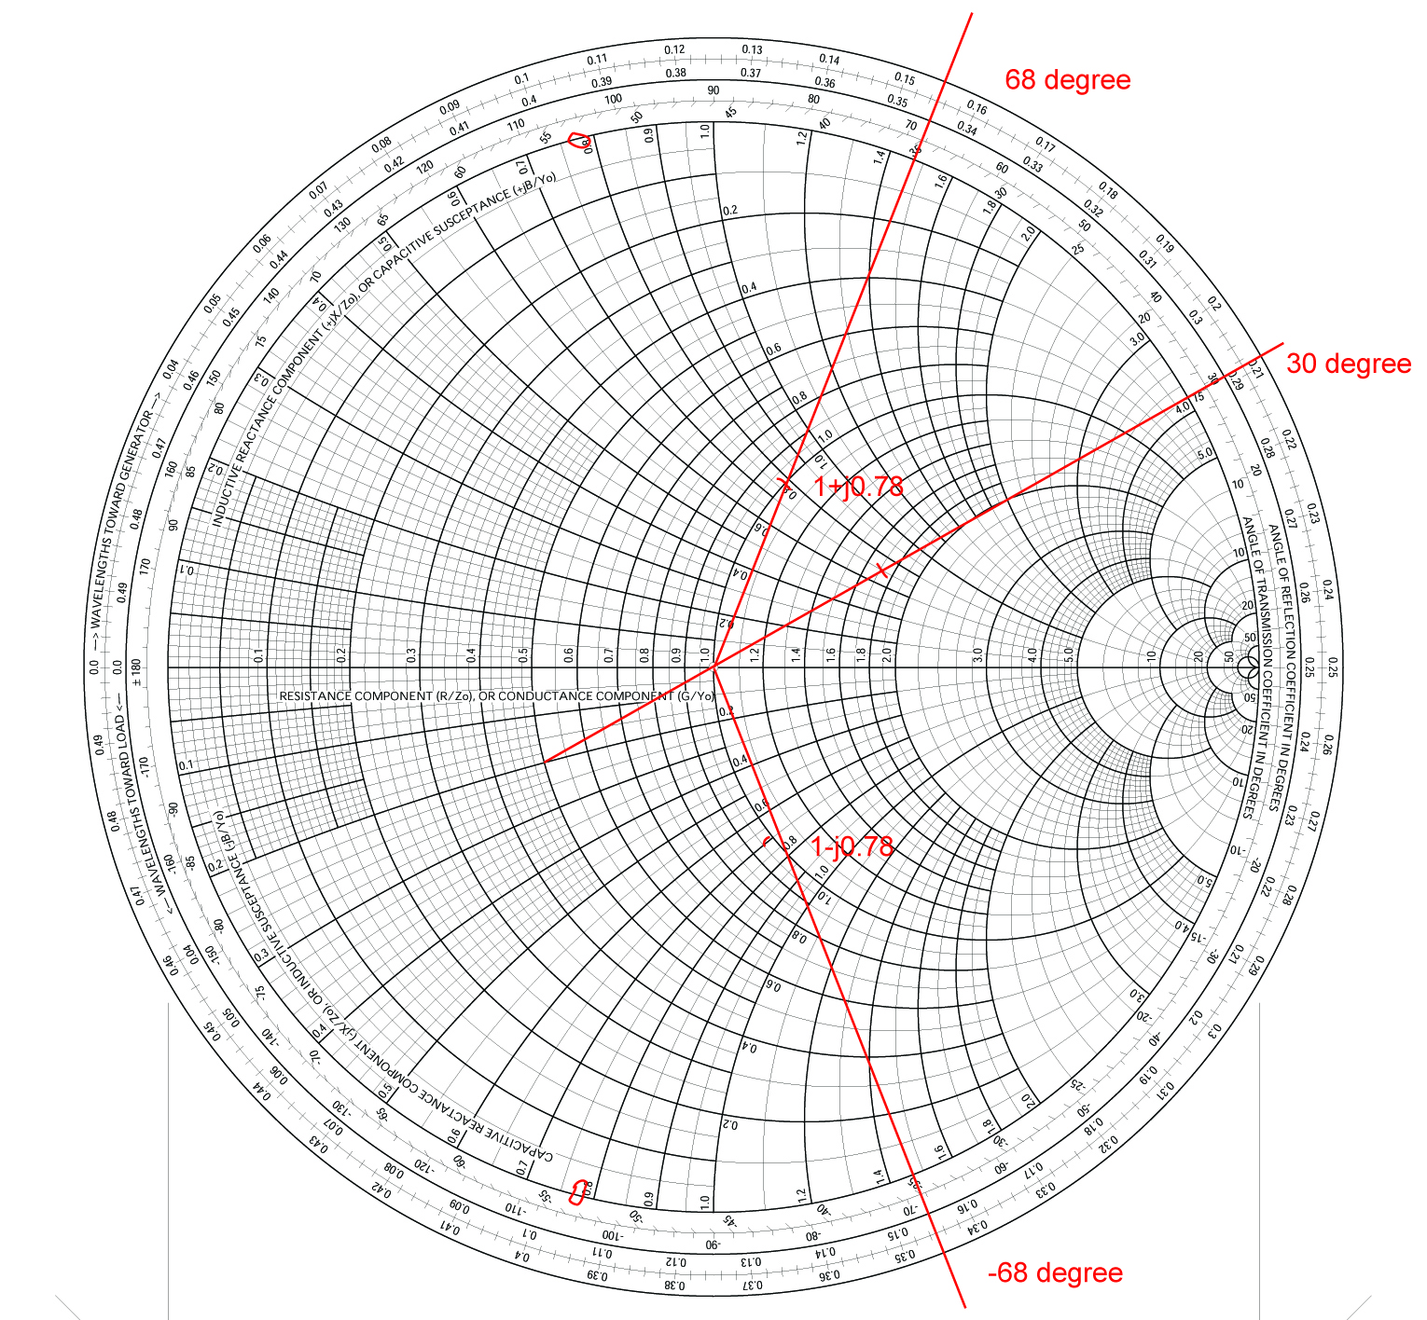

Slide 23
Plane Wave
Wave solution in simple cases
e.g. propagates along +z direction, has only Ex components
Wave number, velocity, intrinsic impedance of material
Lossy medium: complex permittivity, depth of penetration
In good conductor: skin depth, surface impedance
Polarization: LP, LHCP, RHCP, LHEP, RHEP
Reflection: Snell’s law, critical angle, TEz mode, TMz mode

Slide 24
Plane Wave in Lossless Media
z
S
y
H
E
x
Time domain:

Slide 25
Plane Wave in Lossy Media
Time domain:
tanδ << 1: low-loss medium (attenuation is independent of frequency)
tanδ >> 1: high-loss medium (good conductor)

Slide 26
Plane Wave in Good Conductor
requirement:
skin depth
surface impedance
surface resistance

Slide 27
Three Types of Polarization
LP: linear polarization
CP: circular polarization: LHCP / RHCP
EP: elliptical polarization: LHEP / RHEP
e.g.
(can propagate along other directions)
LP: if
CP: if
EP: if not LP or CP

Slide 28
Handedness of Polarization
The electric field vector rotates from the leading axis to the lagging axis.
Find out the handedness: your thumb points along the wave propagation direction, the curl of the other four fingers follows the rotations of electric field vectors.

Slide 29
Reflection and Transmission
critical angle

